Slide 1
Vector-based navigation using grid-like representations in artificial agents
Banino et. al. Deepmind. Nature. 2018.
Presenter: Weizhi Wang
Jan. 2021

Slide 2
How we navigate?
Locate and Compute Distance
Hippocampus 海马体 and Entorhinal Cortex 内嗅皮层
Place Cells: Find where you are now
Active when you reached a certain place in environment
Grid Cells: Distance Sensing and Coordinate System
Active when you reached an end-point of virtual cognitive map
Grid Cells and Place Cells enable a sense of place and navigational ability
Head Direction Cells: Sensing Moving Direction
Active when your head is pointing a specific direction like north
Border Cells: Sensing an Environment Boundary
Notes:
For machine learning people:
The first part will give evidence that grid cells are used for lots of things in the brain
Then you’ll receive different answers to “how is this relevant to machine learning” through the talks

Slide 3
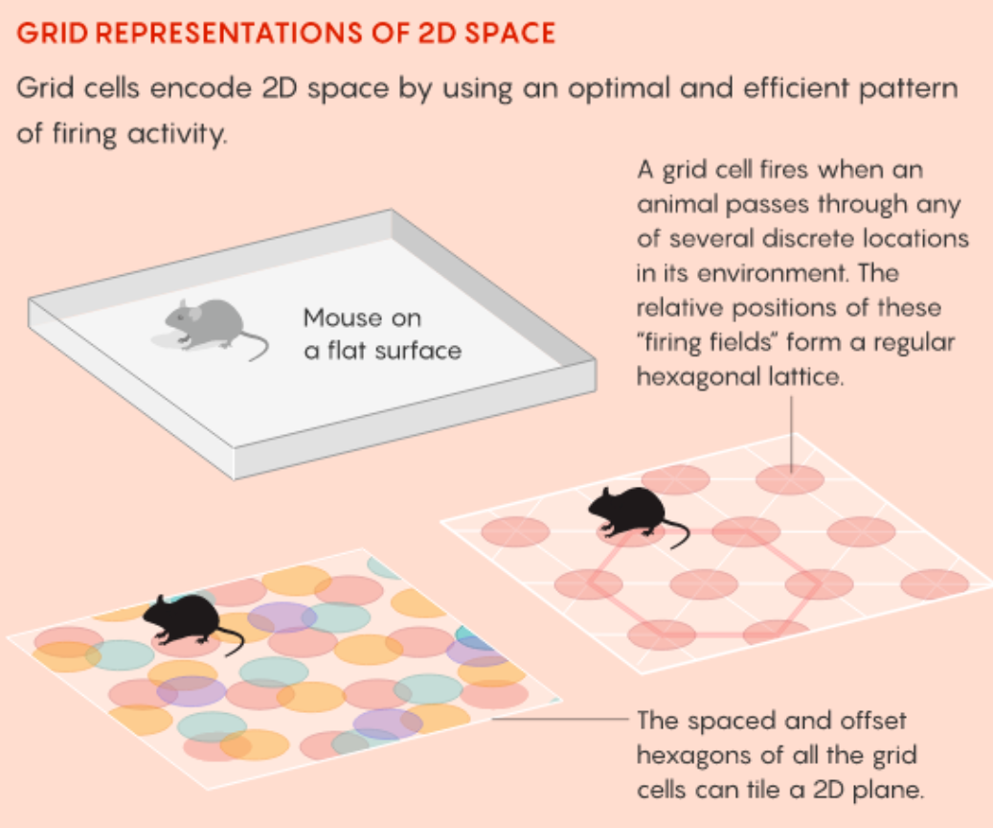
Grid cell forms a virtual coordinate system

Slide 4
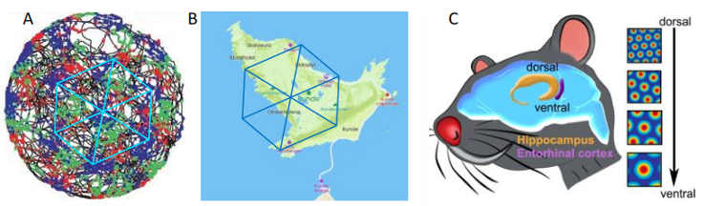
Grid cell represents realistic environment
Figure 2. The environment under grid cell coordinate system. (A) Three grid cells in a circle environment. (B) The coordinate system of cognitive map. (C) Grid cell holds various plotting scales.

Slide 5
Research Question
Can our artificial agents take advantage of the same grid-like representation to realize high precision vector-based navigation?
Q1: How to make artificial agents generate the grid-like representation?
Q2: Can the grid-like representation help agents achieve high quality vector-based navigation?

Slide 6
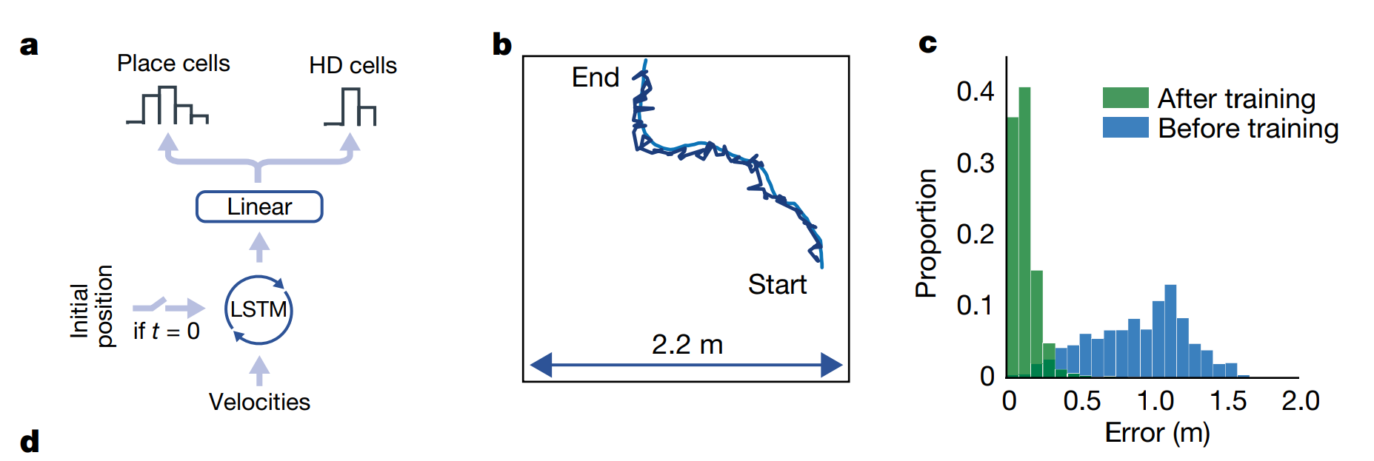
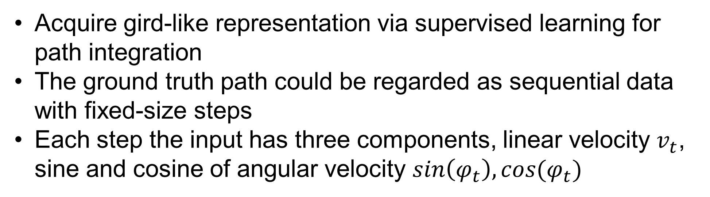
Grid Cell Network
Figure 3. (A) Grid cell network. (B) Path integration. (C) Error rate.
Acquire gird-like representation via supervised learning for path integration
The ground truth path could be regarded as sequential data with fixed-size steps
Each step the input has three components, linear velocity $v_{t}$, sine and cosine of angular velocity $sin\left(φ_{t}\right), cos(φ_{t})$

Slide 7
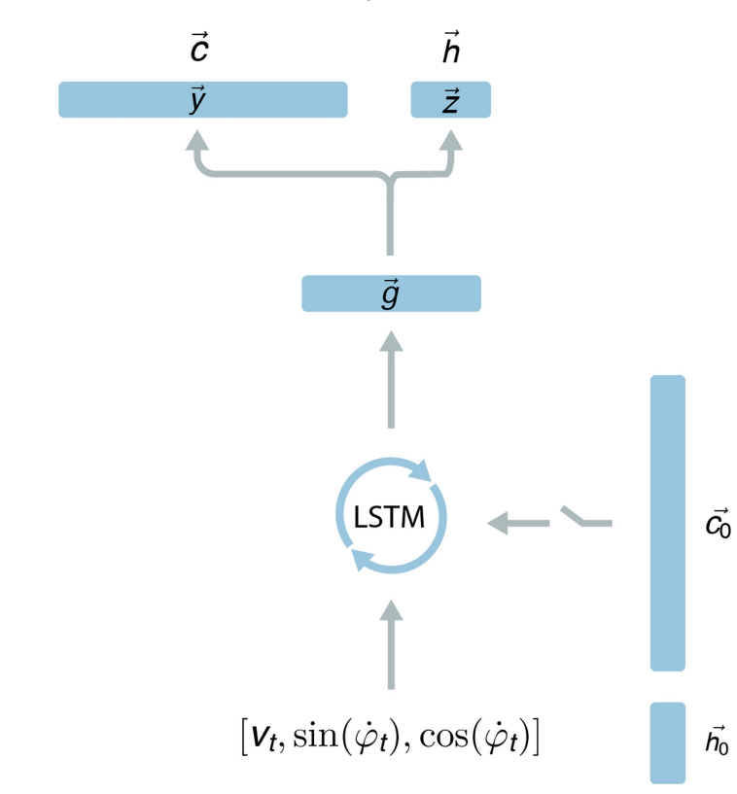
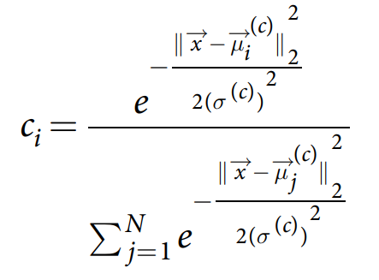
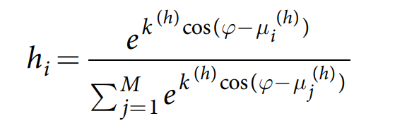
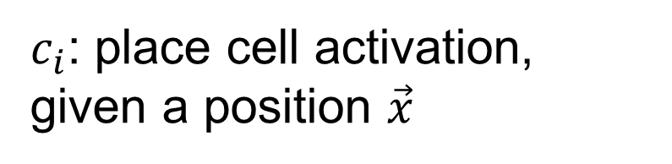
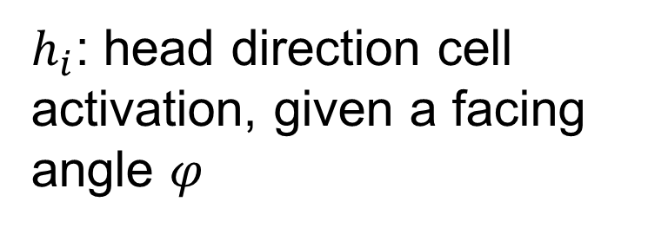
Grid Cell Network
$c_{i}$: place cell activation, given a position $\vec{x}$
$h_{i}$: head direction cell activation, given a facing angle $φ$

Slide 8
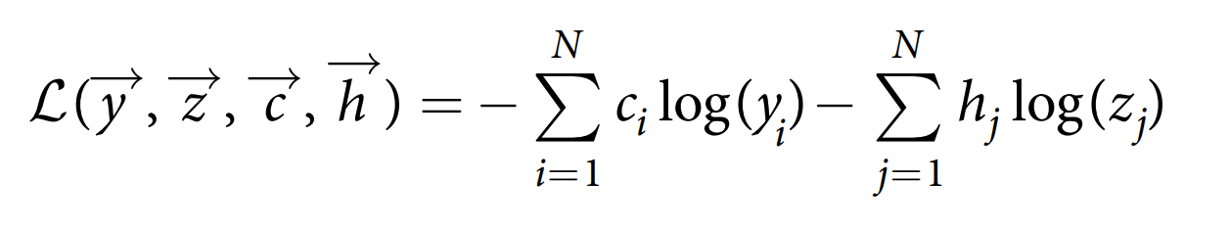
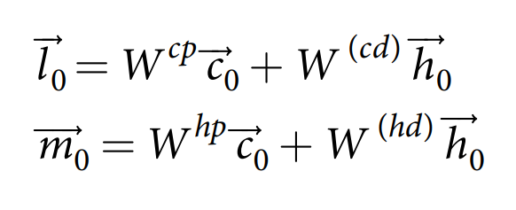
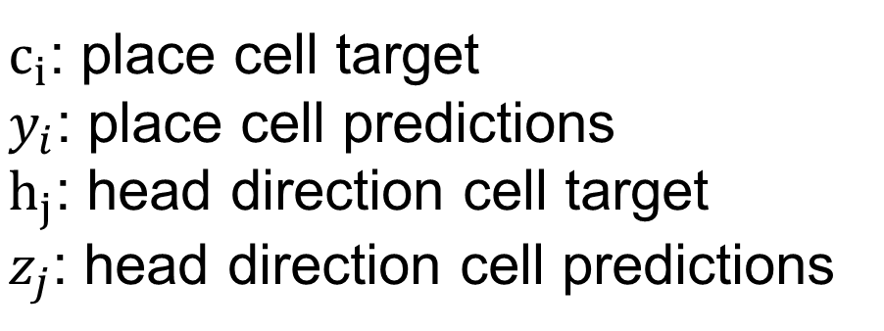
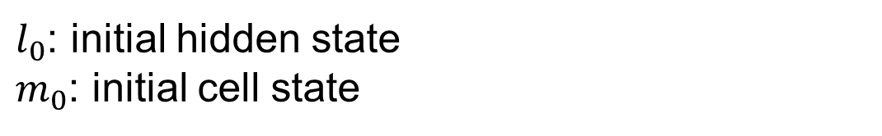
Grid Cell Network
Training:
$c_{i}$: place cell target
$y_{i}$: place cell predictions
$h_{j}$: head direction cell target
$z_{j}$: head direction cell predictions
$l_{0}$: initial hidden state
$m_{0}$: initial cell state

Slide 9
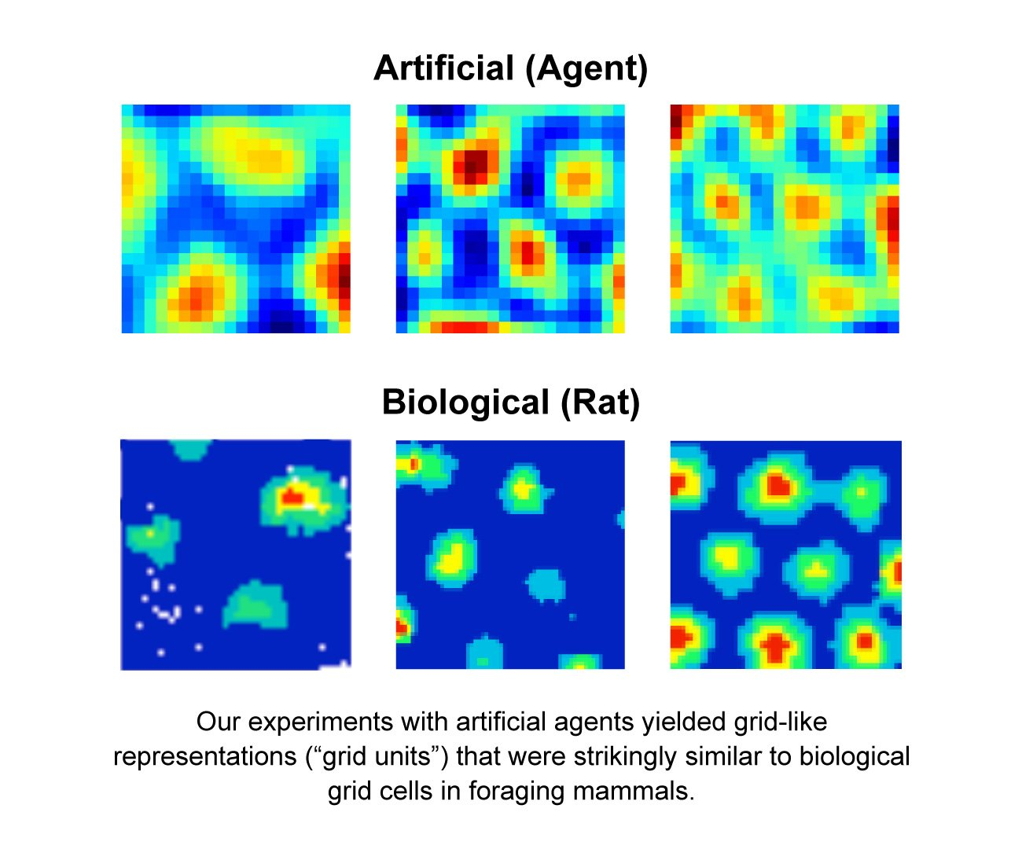
Gird-like Representation

Slide 10
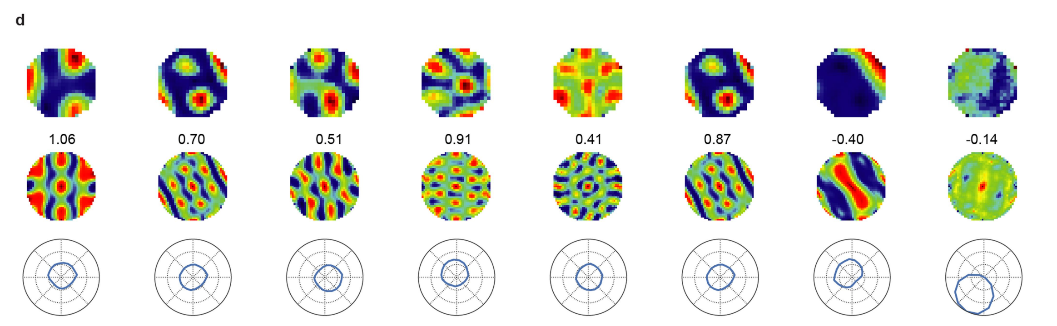
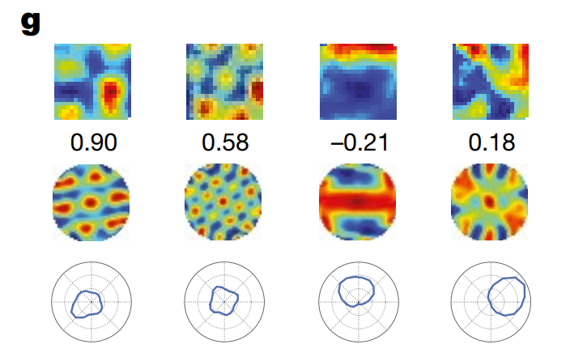
Gird-like Representation

Slide 11
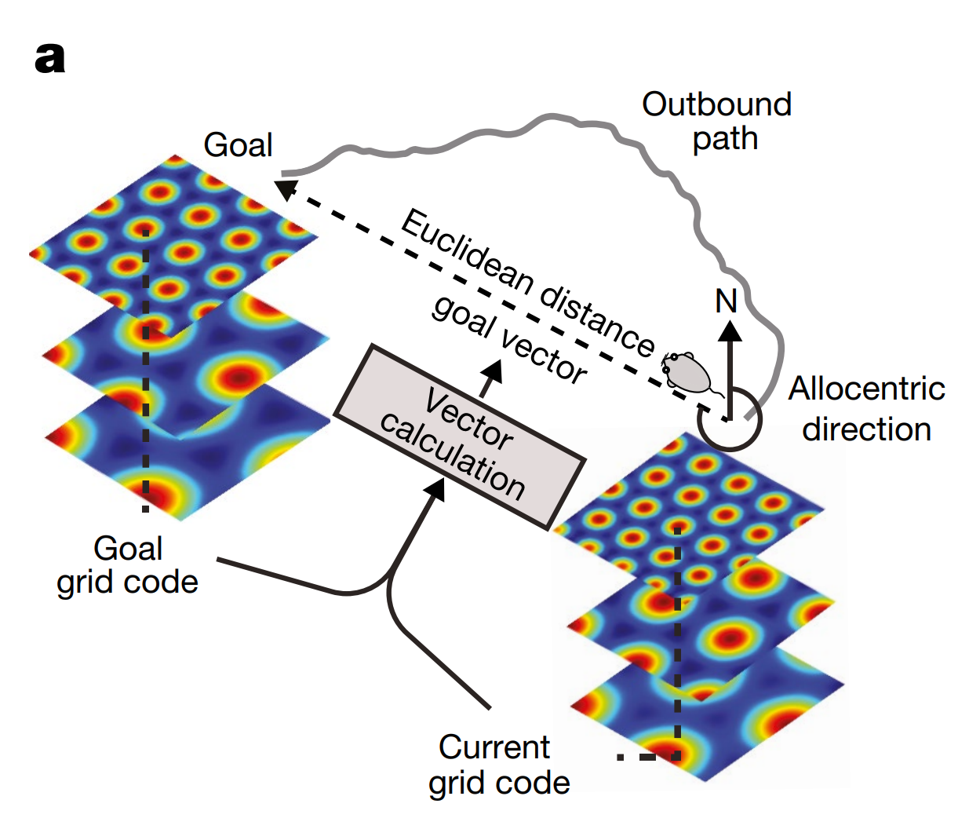
Vector-based Navigation
Grid cells provide a Euclidean spatial metric and thus to support the calculation of goal-directed vectors
Enabling animals to follow direct routes to a remembered goal

Slide 12
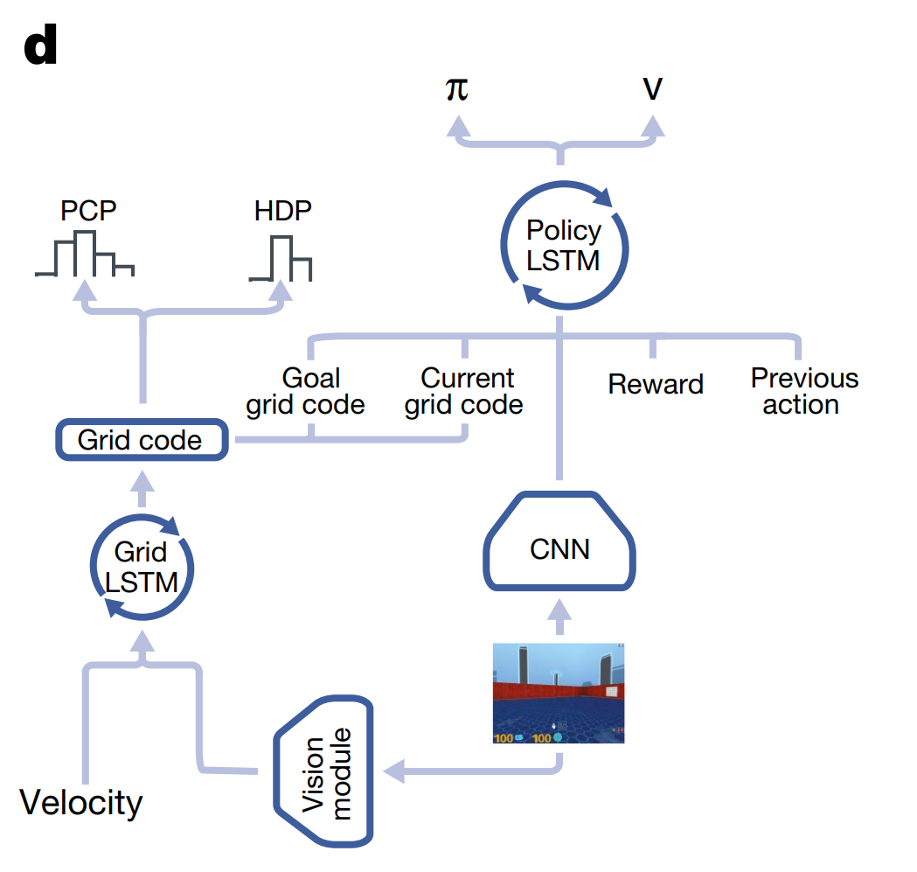
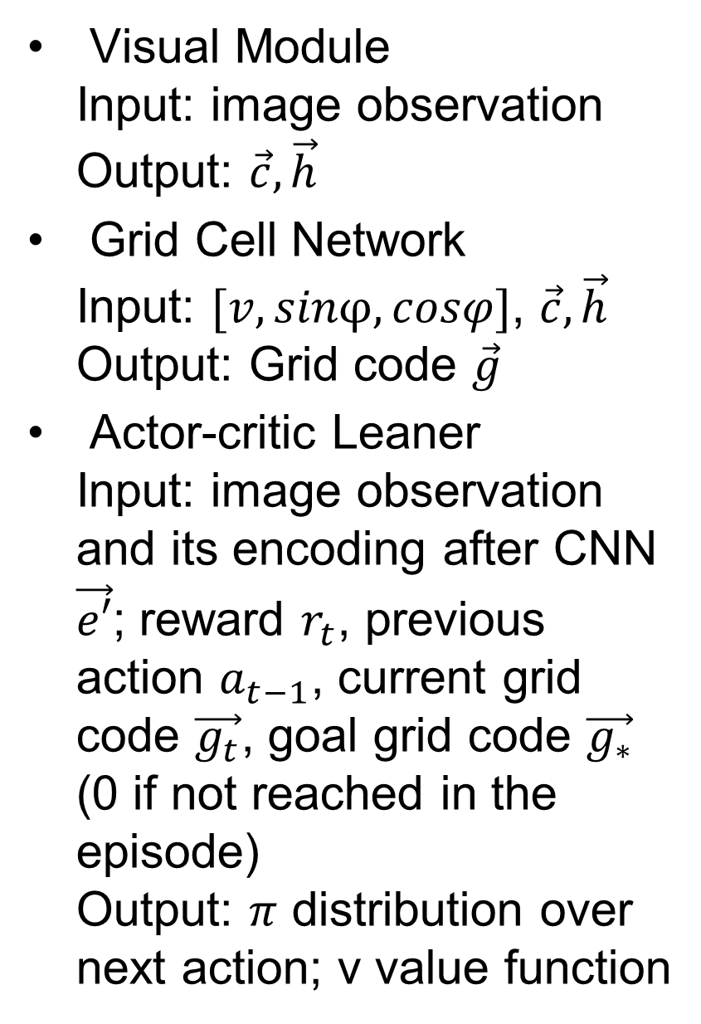
Artificial Agent with Grid-like Representation
Visual Module
Input: image observation
Output: $\vec{c}, \vec{h}$
Grid Cell Network
Input: $[v, sinφ,cosφ]$, $\vec{c}, \vec{h}$
Output: Grid code $\vec{g}$
Actor-critic Leaner
Input: image observation and its encoding after CNN $\vec{e′}$; reward $r_{t}$, previous action $a_{t−1}$, current grid code $\vec{g_{t}}$, goal grid code $\vec{g_{∗}}$ (0 if not reached in the episode)
Output: $π$ distribution over next action; v value function

Slide 13
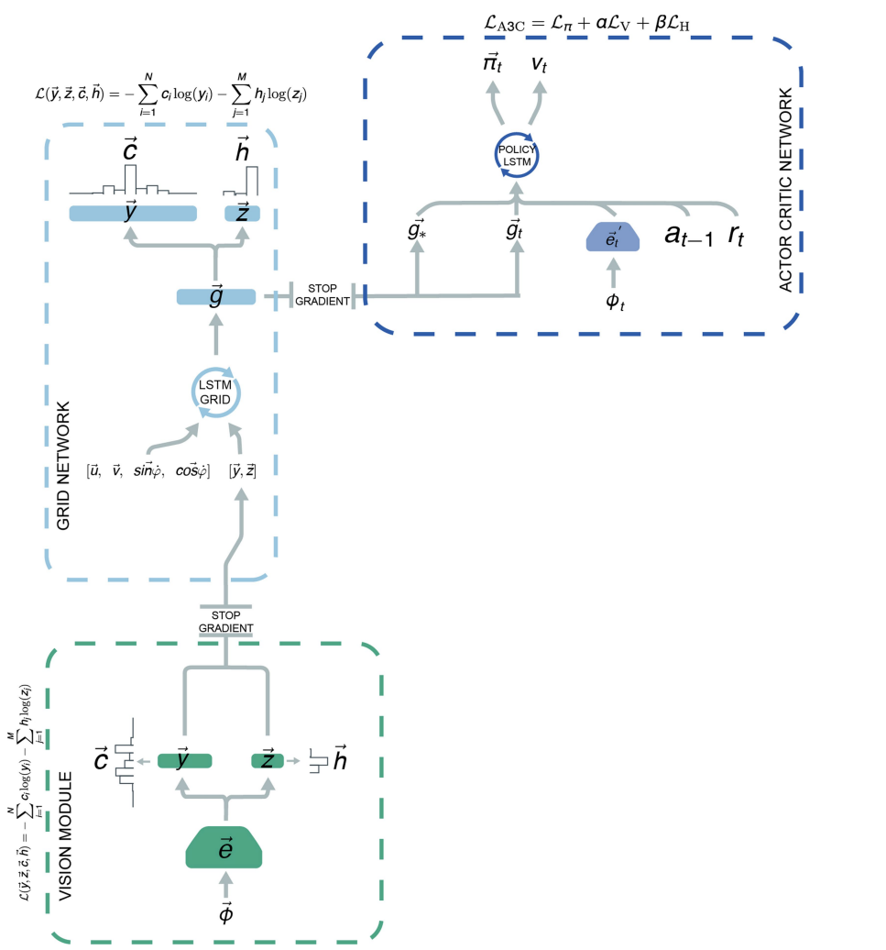
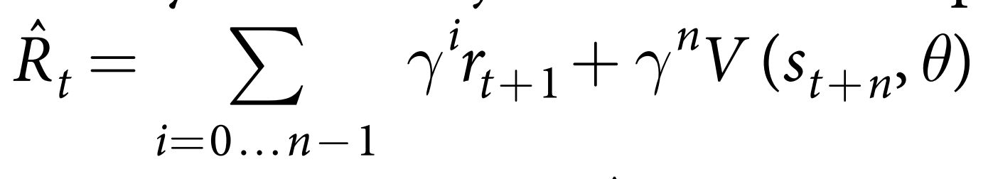
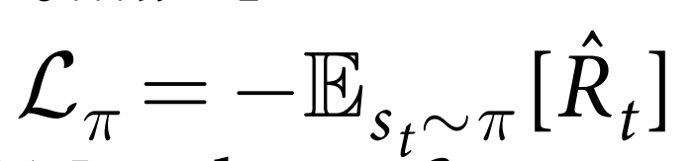
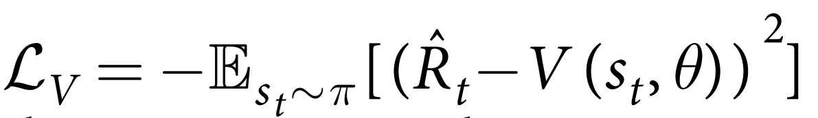
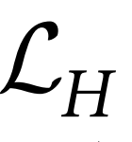
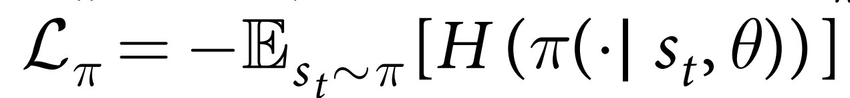

Slide 14
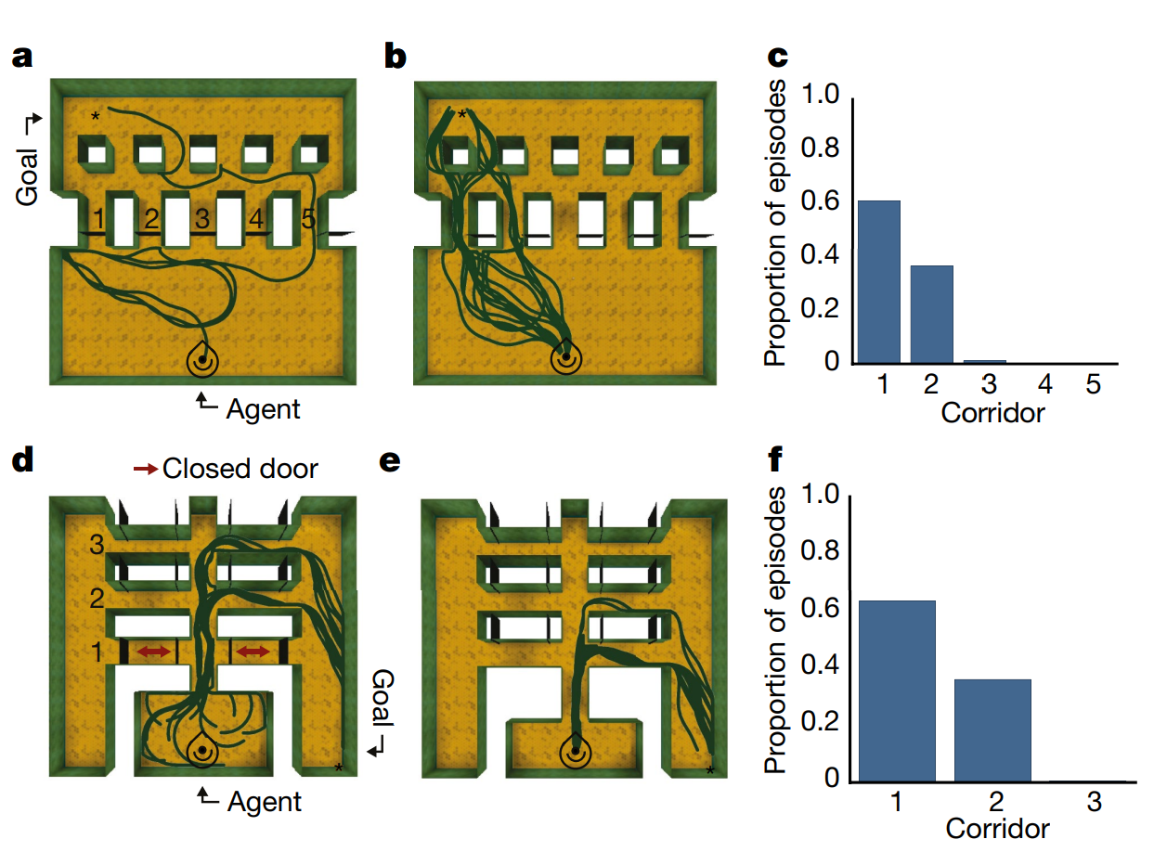
Flexible use of shortcuts
Case 1: Training: only door 5 open; Inference: all doors open
Case 2: Training: door 1 closed; Inference: all doors open

Slide 15
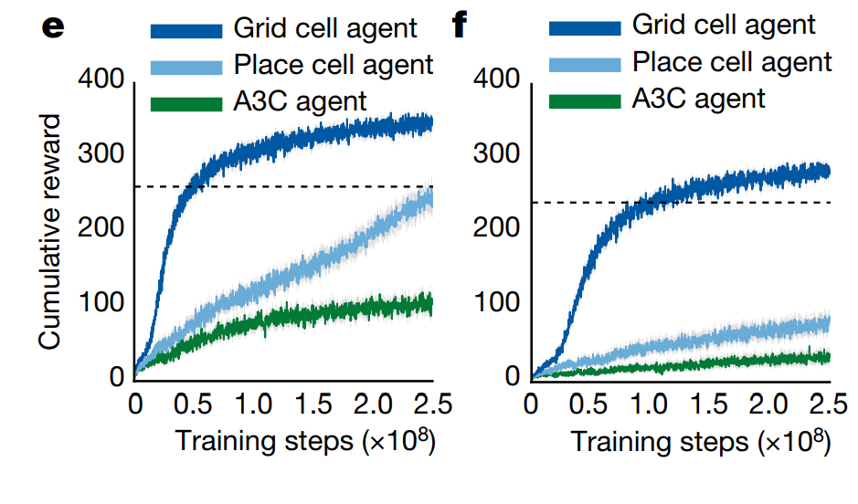
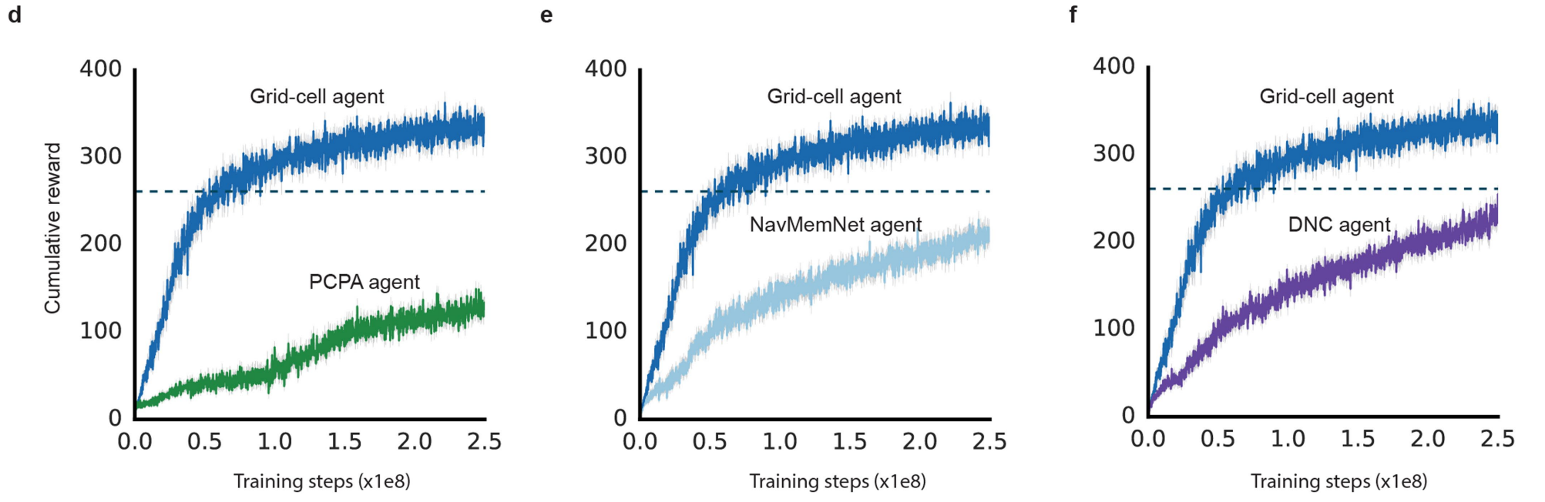
Metric Comparison

Slide 16
Conclusion
Grid like representation can provide an effective basis for flexible navigation in challenging novel environment.
This work supports theoretical models of grid cells in vector-based navigation that were previously lacking strong empirical support.
Grid-like representations furnish agents with a Euclidean geometric framework—paralleling their proposed computational role in mammals as an early-developing Kantian-like spatial scaffold that serves to organize perceptual experience.

Slide 17
Thank you!

